Slide 1
Never Let Me Go
A novel by Kazuo Ishiguro
Brianna G. Bourgeois
Department of Human Rights, St. Thomas University
HMRT 2023 A: Human Rights and Literature
Dr. DiPaolo
December 13, 2020

Slide 2
Novel Summary
Never Let Me Go by Kazuo Ishiguro is a fictional novel based in England during the late 1990s. The novel follows the story of Kathy, Ruth, and Tommy, at Hailsham boarding school where they live as organ donors.
Growing up in the age of scientific advancement, the children exist as human clones. Essentially, the children grow up to donate their organs until they are “complete”, or in other words, until they pass away.
The children form connections, feel emotion and experience life in the same way that a “human” would yet, they are secluded from the rest of the world, and stripped of their dignity.
Although fictional, the novel highlights the risks and downfalls of scientific advancements and medical experimentation and the ethical paradigm that exists between them.

Slide 3
Key Human Rights Issues in the Novel
Never Let Me Go by Kazuo Ishiguro follows the story of Ruth, Tommy and Kathy and their experiences at Hailsham, where they live as organ donors. Ultimately, the children grow up with the sole purpose of donating their organs to those in need. As such, there are several human rights issues highlighted in the novel.
Dehumanization and exploitation: Throughout the novel, the children are feared, dehumanized, and exploited. To the outside world, they existed “only to supply medical science” (Ishiguro 261). The children are consistently exploited through the organ harvesting process that forces them to donate to the humans that look down on them as view them as less than. At the end of the novel, the children learn that Hailsham existed to “demonstrate to the world that if students were reared in humane, cultivated environments, it was possible for them to grow to be as sensitive and intelligent as any ordinary human being” (Ishiguro 261).
Medical and scientific experimentation: The topic of medical and scientific experimentation is central to the novel. Essentially, the children exist for the purpose of medical experimentation where they serve their whole lives donating their organs in an attempt to cure disease and medical conditions. If the scientific advancements in the novel never considered the idea of human cloning as a way to solve medical problems, the children would have never been brought into the world.
Threats to human dignity: To exist is to have the right to dignity where equal respect is given to all. From the time the children were brought into the world, their dignity was at risk. They were constantly experimented on, exploited and used for their organs; something that they never consented to.

Slide 4
Connecting the Novel to Human Rights
“However uncomfortable people were about your existence, their overwhelming concern was that their own children, their spouses, their parents, their friends, did not die from cancer, motor neurone disease, heart disease. So for a long time you were kept in the shadows, and people did their best not to think about you. And if they did, they tried to convince themselves you weren’t really like us. That you were less than human so it didn’t really matter.” (Ishiguro 263)

Slide 5
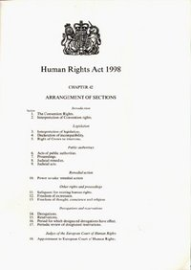
Applicable Domestic Human Rights Law
Great Britain Human Rights Act 1998
Right to liberty and security
Right to life
Freedom from torture and inhuman or degrading treatment

Slide 6
How Have Domestic Human Rights Laws Been Violated?
Great Britain Human Rights Act 1998
The Great Britain Human Rights Act acknowledges the human rights to liberty and security, the right to life, and freedom from torture or inhuman and degrading treatment.
In the novel, the children do not have any control over their fate. Ultimately, they were born to spend their lives donating their organs to others before dying. The right to liberty and security cannot be upheld when they are confined to Hailsham, forced to donate their organs, and ultimately, die for a population that views them as inferior.
Although infringements to the right to life would typically include instances of murder or capital punishment, organ donation in the novel violates such right. The children were born with the duty of donating their organs in order to help cure disease, and treat medical conditions. Each time the children donate their organs, their lives are cut shorter until they “complete” and do not have the organs left to survive.

Slide 7
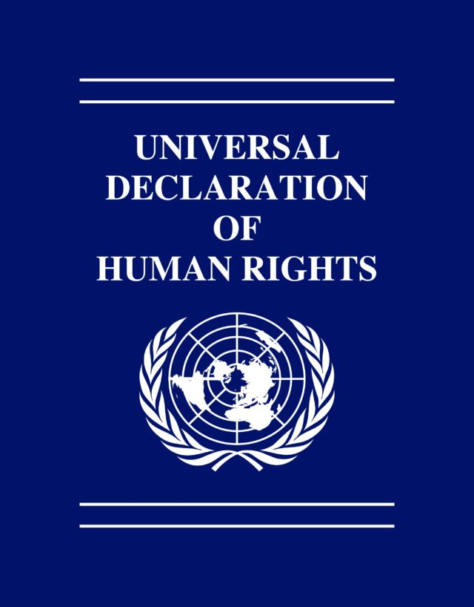
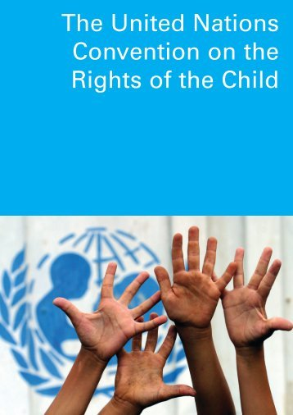
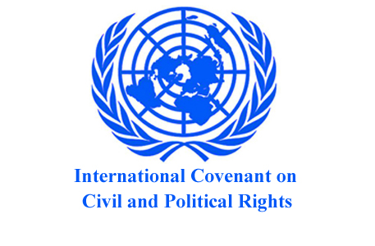
Applicable International Human Rights Laws
Universal Declaration of Human Rights
Convention on the Rights of the Child (CRC, 1989)
International Covenant on Civil and Political Rights (ICCPR, 1966)

Slide 8
How Have International Human Rights Laws Been Violated?
Universal Declaration of Human Rights
Article 1:All human beings are born free and equal in dignity and rights. They are endowed with reason and conscience and should act towards one another in a spirit of brotherhood.
Article 5: No one shall be subjected to torture or to cruel, inhuman or degrading treatment or punishment.
Article 25 (1): The right to a standard of living adequate for the health and well being of himself or his family.

Slide 9
How Have International Human Rights Laws Been Violated?
Convention on the Rights of the Child (CRC, 1989)
Article 3 (3): States Parties shall ensure that the institutions, services and facilities responsible for the care or protection of children shall conform with the standards established by competent authorities, particularly in the areas of safety, health, in the number and suitability of their staff, as well as competent supervision.
Article 19 (1): Protection against all forms of physical or mental violence, injury or abuse, neglect or negligent treatment, maltreatment or exploitation.
Article 27 (1): Every child has the right to a standard of living adequate for the child’s physical, mental, spiritual, moral and social development.

Slide 10
How Have International Human Rights Laws Been Violated?
International Covenant on Civil and Political Rights (ICCPR, 1966)
Article 6(1): Everyone has the inherent right to life.
Article 7: No one shall be subjected to torture or to cruel, inhuman or degrading treatment or punishment. In particular, no one shall be subjected without his free consent to medical or scientific experimentation.

Slide 11
Case Study: ‘Dream Babies’ in China
Scientists have been examining the gene-editing procedure CRIPSR Cas-9 after it was introduced by American molecular biologist Jennifer Doudna in 2012 (Brophy 163).
In 2018, He Jiankui claimed that he brought into the world the first genetically edited babies named Lulu and Nana. When questioned at the International Summit on Genome Editing in Hong Kong, he revealed that he represented the experiment to his participants as a study into an HIV/AIDS vaccine and they were not fully aware of what they were consenting to (Brophy 162).
The ethics committee he cited as overseeing the ‘trial’ had no knowledge of it and the evidence contained a reference to the advancements of the People’s Republic of China’s global reputation for scientific innovation as an ethical justification for the procedure (Brophy 162-163).
The birth of Lulu and Nana brought light to the ethical and moral dangers of scientific advancement and medical experimentation.
He Jiankui was sentenced to 3 years in prison for violating medical regulations (The Guardian).

Slide 12
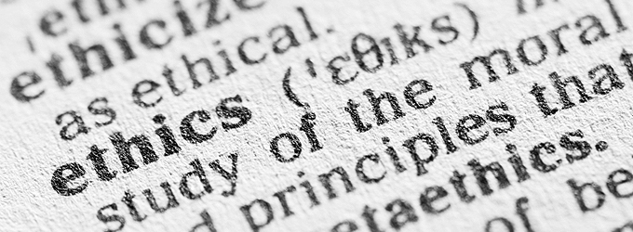
Key Human Rights Issue
The ethical implications of medical experimentation and its subsequent threat to human dignity:
The couple went to He Jiankui with the concern that they would pass on HIV/AIDS to their children. The couple never consented to genetic modification yet, He Jiankui completed the procedure without their knowledge.
Gene editing is banned in several countries and it is unknown whether the procedure is safe or, if used in pregnancy, whether it can have unintended consequences for the babies later in life or for future generations. (Hollingsworth & Yee)

Slide 13
Applicable Domestic Human Rights Laws
“The Chinese government implements a family planning policy in the light of the Constitution, with the aim of promoting economic and social development, raising people's living standards, enhancing the quality of its population and safeguarding the people's rights to enjoy a better life.” ( Human Rights in China)
“China's population policy has two objectives: control of population growth and improvement in quality of the population. Work in this field not only encourages couples of child-bearing age to have fewer children but also provides them with mother care, baby care and advice on optimum methods of child-bearing and child-rearing. These services include premarriage check-ups, heredity consultation, pre-natal diagnosis and care during pregnancy to help couples have sound, healthy babies.” (Human Rights in China)

Slide 14
How Have Domestic Human Rights Laws Been Violated?
The laws prescribed under Chinese human rights laws look to safeguard human rights by acknowledging family planning rights.
Although their family planning regulations restrict the number of children an individual can have, they recognize the importance of prenatal care in rearing healthy babies.
Prenatal care is essential however, it is defined as check-ups, heredity consultation, and prenatal diagnosis.
Genetic modification does not qualify as “prenatal care” and is a practice that contravenes against the existing human rights laws.

Slide 15
Applicable International Human Rights Laws
Universal Declaration of Human Rights
Article 1: All human beings are born free and equal in dignity and rights.
International Covenant on Civil and Political Rights (ICCPR, 1966)
Article 1: All human beings have the right to self determination.
Article 7: No one shall be subjected to torture or to cruel, inhuman or degrading treatment or punishment. In particular, no one shall be subjected without his free consent to medical or scientific experimentation.

Slide 16
How Have International Human Rights Laws Been Violated?
Article 1 of the Universal Declaration of Human Rights provides that all human beings are born equal in dignity and rights. In the situation of ‘Dream Babies’, genetic modification allows for children to be born with specific traits. As such, this modification essentially allows for a child to be engineered to be ‘perfect’. How can all human beings have equal rights and dignity when genetic modification allows for some to be born with ‘perfect’ traits that place them at an advantage?
The International Covenant on Civil and Political Rights allows the right to self determination. Genetic modification ultimately functions to create a genome that fits the mold of the specific characteristics that an individual wishes for their child to possess therefore, violating these rights. Further, the Covenant prohibits non-consensual medical and scientific experimentation. If a child is born after being genetically edited, they did not have any say in such experimentation and as such, have had their rights violated.

Slide 17
Outcomes in the Novel vs Outcomes in Real Life
Novel | Real Life
Hailsham loses funding as is forced to close. Ruth and Tommy “complete” after donating her organs. Kathy is left by herself with nothing more than the memories of her friends that left her too soon. | - Lulu and Nana are still alive and a third child has been born as a result of Jiankui’s experiments (Sample). -He Jiankui was sentenced to three years in jail as a result of the unethical medical experimentation (Sample).

Slide 18
Alleviating the Human Rights Issue
As science continues to progress and individuals continue to push for innovation in the field of medicine, it is necessary that steps are taken to ensure that it is advancing in an ethical and humane manner.
As seen in the novel and in the real-life ‘Dream Babies’ case study, it is clear that while medical experimentation and scientific advancements pertaining to genetic modification and organ harvesting provide an appealing alternative to curing disease, and preventing the inheritance of specific genetic traits, it is unethical and places human dignity at risk.
Solutions to combat the threat of scientific advancement and medical experimentation on human dignity include:
Prohibition of genetic editing and modification to promote the protection of human rights and to prohibit procedures that interfere with an individuals biological makeup for purposes that are solely cosmetic or for trait enhancement.
There must be a push for all governments who perpetuate forced organ donation to be held accountable. One way for this to be accomplished is to advance the concerns during Universal Periodic Review.
Develop a human rights framework concerning medical experimentation and scientific advancement, outlining the key ethical issues and how they relate to the protection of human rights. After reading the novel and examining the ‘Dream Babies’ case study, it is clear that using humans as a means for experimentation is dehumanizing, and unethical.

Slide 19
Works Cited
Brophy, Jane. "DREAM BABIES." In China Dreams, edited by Golley Jane, Jaivin Linda, Hillman Ben, and Strange Sharon, 161-66. Australia: ANU Press, 2020. Accessed December 12, 2020. doi:10.2307/j.ctv12sdxmk.18.
Hollingsworth, Julia and Issac Yee. “Chinese scientist who edited genes of twin babies is jailed for 3 years.” CNN, 30 December 2019. He Jiankui: Chinese gene-editing scientist jailed for 3 years - CNN
Information Office of the State Council Of the People's Republic of China. “Human Rights in China”. 1991, Beijing. Human Rights in China (chineseembassy.org)
Ishiguro, Kazuo. Never Let Me Go. Vintage Canada, 2005.
Sample, Ian. “Chinese Scientist Who Edited Babies Genes Jailed for 3 years.” The Guardian, 31 December 2019. Chinese scientist who edited babies' genes jailed for three years | World news | The Guardian
The Human Rights Act 1998 (c. 42), United Kingdom.
UN Commission on Human Rights, Convention on the Rights of the Child., 7 March 1990, E/CN.4/RES/1990/74, available at: https://www.refworld.org/docid/3b00f03d30.html [accessed 13 December 2020]
UN General Assembly, International Covenant on Civil and Political Rights, 16 December 1966, United Nations, Treaty Series, vol. 999, p. 171, available at: https://www.refworld.org/docid/3ae6b3aa0.html [accessed 13 December 2020]
UN General Assembly, Universal Declaration of Human Rights, 10 December 1948, 217 A (III), available at: https://www.refworld.org/docid/3ae6b3712c.html [accessed 13 December 2020]

